Slide 1
Programming for ECE
Week 7
Part 2

Slide 2

New Stuff
How many data types have you seen so far?

Slide 3
Data Types
int
float
double
bool
char
string
actually, an object, but acts like a type

Slide 4

Modifiers
We can modify some existing data types

Slide 5
New Modifiers
Two new types:
short:
a "short" integer
Size of 2 bytes
Example:
short x = 55
short int y = 55 ;
long:
A "long" integer
Size of 4 bytes (in C and C++)
Example:
long x = 577799 ;
long int y = 5700033449990 ;
In C and C++, int and long are the same
Note: in most other languages, long is 8 bytes (see this table)
0000 0000
0011 1111

Slide 6
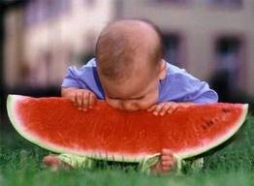
New Modifiers
Another new type:
long long:
A "really long" integer
Size of 8 bytes (in C and C++)
Range:
–9,223,372,036,854,775,808
to
9,223,372,036,854,775,807
Example:
long long x = 577799 ;
long long int y = 9223372036854775807;
Note: this works in Microsoft Visual Studio 2005 and up; may not work in other compilers

Slide 7
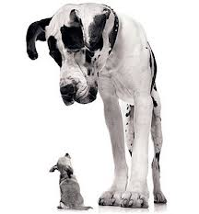
More on sizes
char x = 255 ;
What if you want 1-byte storage?
In some languages you do this:
byte x = 255
In C and C++:
char x = 255 ;
Be careful:
char x = 78;
char y = 41;
cout << x + y;
1111
1111
%

Slide 8
Even more:
Two new keywords:
signed
unsigned
Which leads us to:
How positive and negative integers are represented.

Slide 9
Signed Integers
MSB is the sign
Signed:
Can represent
positive and negative integers:
Range:
int (which is 4 bytes) can store:
-2,147,483,648 to 2,147,483,647
-2³¹ to 2³¹-1
Uses 31 bits for value and one bit for the sign:
0 for postive
1 for negative
Integer variables are signed by default in C/C++
0000 0000
0000 0000
0000 0000
0000 0101
int z = 5;

Slide 10

Signed Integers
Signed:
Can represent positive and negative integers:
Examples – these are the equivalent:
signed int x ;
signed x ;
Assigning value:
signed int x ;
x = -725 ;
x = 578 ;
x = -2147483648 ;
x = 2147483647 ;

Slide 11
Signed Integers
What's really there?
signed int x = 5 ;
signed int x = -5 ;
0000 0000
0000 0000
0000 0000
0000 0101
THIS
0033FF00
0033FF01
0033FF02
0033FF03
1000 0000
0000 0000
0000 0000
0000 0101
NOT THIS
0033FF00
0033FF01
0033FF02
0033FF03
1111
1111
1111
1111
1111
1111
1111
1011
This is the 2's complement of 5; how negative integers are really stored.
0033FF00
0033FF01
0033FF02
0033FF03

Slide 12
2's Complement
Makes it easy – and fast - to add and subtract in hardware
How to do it:
Convert to binary
Invert the magnitude part
but not the sign
Add binary 1

Slide 13
2's Complement
Example:
signed int x = 5 ;
x = -x;
Do in 8 bits for simplicity:
5₁₀ would be 0000 0101₂
To negate:
Make Most Significant Bit = 1: 1000 0101
Invert the rest of the bits: 1111 1010
+1
Add 1: 1111 1010 + 1 = 1111 1011

Slide 14
2's Complement
Plus sign
0
0
0
0
0
0
0
1
1₁₀
+ to -
Invert
Invert
Invert
Invert
Invert
Invert
Invert
1
1
1
1
1
1
1
0
Minus sign
+1
Add 1
1
1
1
1
1
1
1
1
-1₁₀

Slide 15
So…
Binary | Decimal
0111 1111 | 127
0111 1110 | 126
0111 1101 | 125
… | …
0000 0011 | 3
0000 0010 | 2
0000 0001 | 1
0000 0000 | 0
1111 1111 | -1
1111 1111 | -2
… | …
1000 0001 | -127
1000 0000 | -128
signed char x ;
(remember: char is a one-byte integer)

Slide 16
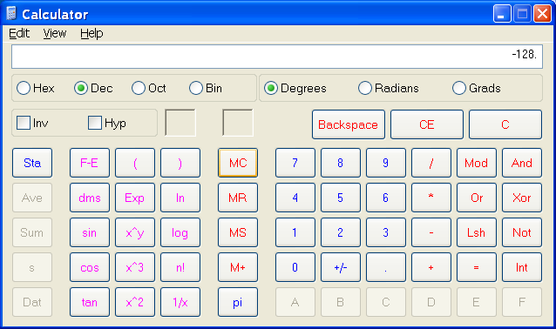
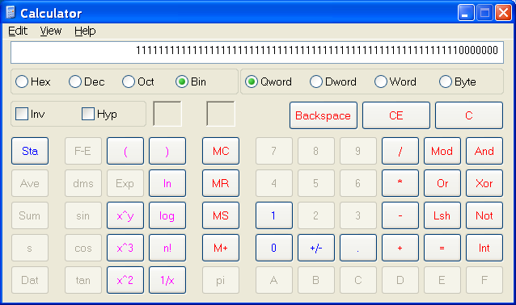
Don't believe it?
Ask Microsoft:

Slide 17
Which is why…
Maximum for signed int:
int is 4 bytes or 32 bits
2³² is 4,294,967,296
But, MSB is the plus/minus sign, so…
Only 31 bits to represent magnitude, so…
Negative: -2³¹ = −2,147,483,648
Positive: (2³¹ – 1) = +2,147,483,678
Zero

Slide 18
Unsigned
unsigned is easy:
No negative numbers
Range:
0 to +4,294,967,295 for unsigned int
0 to +18,446,744,073,709,551,615 for unsigned long long
0 to +65,535 for unsigned short
0 to 255 for unsigned char

Slide 19
To sum up…
Type | <limits.h> Constant | Minimum Value Maximum Value
signed char | SCHAR_MIN SCHAR_MAX | -127 127
unsigned char | UCHAR_MAX | 0 255
signed short | SHRT_MIN SHRT_MAX | -32767 32767
unsigned short | USHRT_MAX | 0 65535
signed int | INT_MIN INT_MAX | -32767 32767
unsigned int | UINT_MAX | 0 65535
signed long | LONG_MIN LONG_MAX | -2147483647 2147483647
unsigned long | ULONG_MAX | 0 4294967295
signed long long | LLONG_MIN LLONG_MAX | -9223372036854775807 9223372036854775807
unsigned long long | ULLONG_MAX | 0 18446744073709551615
DON'T MEMORIZE: these limits are available on line and in code by using <limits.h> constants.

Slide 20

Why do we care?
In principle:
It's reality,
so learn it, know it, live it
In practice:
Speed/timing-critical applications
Small-memory applications (short int)
Large-number applications (long int)
Hardware control (bit patterns)

Slide 21
One more modifier
Constant
A variable that can be:
Declared
Initialized
Not changed
A constant only gets its value when initialized
Can't be assigned a value

Slide 22
const
Examples:
const int PEPPEROINIRADIUS= 1.5 ;
const char SIGMA= 'X' ;
const float MAXBET= 10000.00 ;
const double PI= 3.1415926535897932384626433832795 ;

Slide 23
Constant rules
You can do this sequence:
const PI = 3.1415926535897932384626433832795 ;
const SLICE= 1 ;
const char ME[] = "Michael" ;
You can't do this sequence:
const double PI = 3.14 ;
PI = 44 ; // can't change a constant

Slide 24
Why use constants?
// Dice.cpp
// Michael Haas, February, 2009
// simulates a simple dice game
const double STARTINGBALANCE = 1000 ; // start with 1000 dollars
int main ()
{
bool playagain = true ;
double bet = 0 ;
double currentbalance = STARTINGBALANCE ;
…
} // end of main function
double Balance(double newamount)
{
static double currentbalance = STARTINGBALANCE ; // starting balance on first call
currentbalance = currentbalance + newamount ;
cout << endl << "Your balance is now: " << currentbalance << endl ;
…
return currentbalance ;
} // end of Balance function
Why?
So you don’t have to search for this.

Slide 25

Questions on Modifiers?

Slide 26
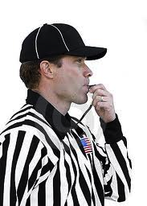
It's Half Time!
7 down
7 to go
7

